Slide 1
The Interrelation of Trombone Range and Resonance
Dr. John G. Shanks
Assistant Professor of Trombone
West Texas A&M University

Slide 2
Brass playing, simplified
Hear singing, musical concept in head
Breathe
Blow singing, musical concept out of horn
… That’s it!

Slide 3
Brass playing, complicated
Doubt yourself
Try to remember physical process from lessons
Take overly noisy breath to show people around you you’re working hard
Create tense embouchure
Jam mouthpiece against face
Clamp down entire body to force air through embouchure
Play inaccurately/inconsistently
Receive negative feedback
Doubt yourself
Rinse, repeat

Slide 4
Have you ever encountered:
Tight/pinched/dull sound soft, brittle loud
Tendency to wander on pitch, usually sharp
Quick upper register fatigue
Inaccuracy after returning from high register
Inconsistency attacking softly
Inability to diminuendo al niente
Extreme effort required to play high
Lack of low register

Slide 5
Turn that smile upside down
Ingredients necessary to play high:
Air support/speed
Vibration
Smiling pulls the lips tense, requiring fast air to escape them/cause vibration… BUT
Smiling also pulls the lips tense, dulling the vibration, making a bad sound.
It’s easy to see from the podium, so we catch it.

Slide 6
OK, no more smiles. Now what?
Specific instruction usually ends here.
Next step for student is usually to recreate the lip tension, just more invisibly, by pressing the lips together.
To escape, the air has to move fast, and causes a fast vibration, so high notes happen… BUT
Again, the lips are tensed, causing a dull, lifeless sound when soft, and a brittle, crackling sound when loud.

Slide 7
Is there even a right way?
Look at reed instruments. Air passes by the reed, interacts w/reed and instrument, causes vibration. Reed is held in place, but not pulled tense or pressed to lifelessness.
Proper brass embouchure functions the same way.
Key: CORNERS.

Slide 8
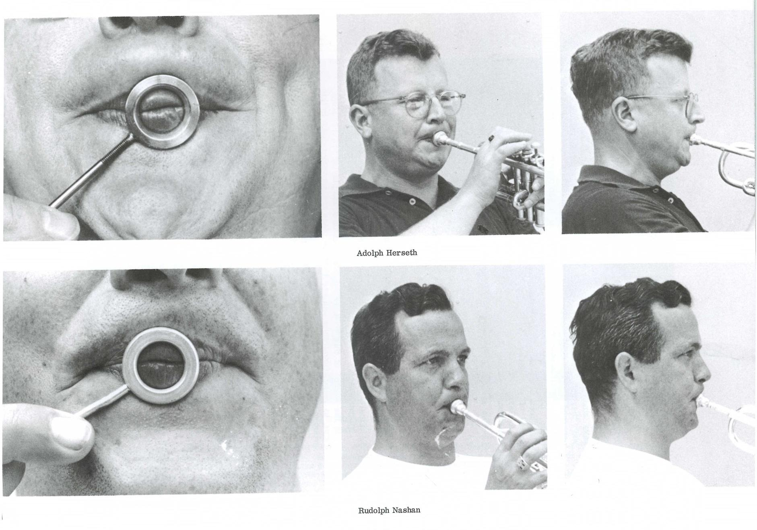
The all-important corners
Brass players often exhibit “Brass Player Face”

Slide 9
Brass face, continued

Slide 10
Brass face, part the third

Slide 11
Brass Player Face
Common element of Brass Player Face: firm corners, flat chin.
Rather than letting the lips collapse into each other, keeping the corners firm allows the lip tissue surrounding the aperture to relax and become resonant.
Vibrating surface (lips) are held in place by corners and mpc – no need for extra tension. Air is free to interact and make a singing tone.

Slide 12
Firm vs supported
The “red tissue” of the lips surrounding the aperture is “soft” – not under muscle tension – but “supported” by the tissue around it (corners, and endpoints of lips)

Slide 13
The ideal embouchure:
Is responsive and supple
Provides the strength to corral the fast air required for high register
Is flexible enough to allow the aperture to adjust to optimal size for the tessitura
Easily transitions throughout the entire range

Slide 14
The face is only one part of the equation
This is already too much focus on the physical.
Make physical adjustments carefully.
Hear it: play it!
Play from the place that you sing.

Slide 15
What they don’t know can’t hurt them
It’s tempting to over-share this information with students, but they may not have the proper framework to understand
Paralysis by analysis is a real thing
Try one variable change, work on it for a week

Slide 16
EXERCISES
Occasional Mouthpiece Buzzing
“Airy Buzz”
Lip Slurs:
Train the embouchure to do “just enough” and not overshoot
Develop supple strength
Encourage the support to come from the corners
Glissandos:
Train the embouchure to do “just enough” and not overshoot
Develop supple strength
Encourage the support to come from the corners

Slide 17
Keeping the buzz exercise
Start low.
Many ways to play high with an OK sound
Only really one way to play low
Not much difference from one position to the next
Therefore – use alternates to gliss the whole horn
Don’t keep the same physical setup, keep the same sound/feel!

Slide 18
I can’t play the trumpet anymore
When this all hit home

Slide 19
Resources
“The Art of Brass Playing” – Philip Farkas
“Lip Slurs” “Lip Slur Melodies” – Brad Edwards
PDFs of “Keeping the Buzz” and others available at www.jgshanks.com (PDFs tab)
Thank you!

